Slide 1
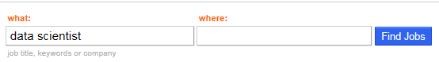


Business problem
Indeed is one of the worlds largest job board. There is an opportunity to 1. improve search accuracy related to salary expectation and also for companies that want to 2. gain market intelligence in a competitive landscape.
✗
1 in 5 jobs are advertised with a salary. Some companies choose not to advertise a salary.
Can we create a predictive model to predict salary?
✓
✓
✗

Slide 2






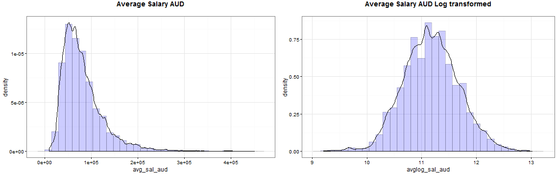
Project Journey
Data Collection
Cleaning
Data Transformation
Feature Creation
Modelling
30,000
Jobs per day
Job Board Salary Predictive Model
Indeed Job Board Data (Primary Source)
Business Problem
Issue
Notes:
high positive skewness of 1.81 and a kurtosis of 5.5.

Slide 3




Model Performance ($k)
Modelling
Linear
Regression
Linear Regression
Stepwise Backwards
Random Forest
Support
Vector Machine
Generalised
Boosted Model
$000
Notes:
Boosting is a type of ensemble method. Ensemble methods refer to a collection of methods by which final predictions are made by aggregating predictions from a number of individual models. Boosting, bagging, and stacking are some widely-implemented ensemble methods. Stacking involves fitting a number of different models individually (of any structure of your own choosing) and then combining them in a single linear model. This is done by fitting the individual models' predictions against the dependent variable. LOOCV SSE is normally used to determine regression coefficients and each model is treated as a basis function (to my mind, this is very, very similar to GAM). Similarly, bagging involves fitting a number of similarly-structured models to bootstrapped samples. At the risk of once again stating the obvious, stacking and bagging are parallel ensemble methods.
Boosting , however, is a sequential method. Friedman and Ridgeway both describe the algorithmic process in their papers so I won't insert it here just this second, but the plain English (and somewhat simplified) version is that you fit one model after the other, with each subsequent model seeking to minimize residuals weighted by the previous model's errors (the shrinkage parameter is the weight allocated to each prediction's residual error from the previous iteration and the smaller you can afford to have it, the better). In an abstract sense, you can think of boosting as a very human-like learning process where we apply past experiences to new iterations of tasks we have to perform.
Now, the gradient part of the whole thing comes from the method used to determine the optimal number of models (referred to as iterations in the gbm documentation) to be used for prediction in order to avoid overfitting.
In statistics, linear regression is an approach for modeling the relationship between a scalar dependent variable y and one or more explanatory variables (or independent variables) denoted X. The case of one explanatory variable is called simple linear regression.
Random forests is a notion of the general technique of random decision foreststhat are an ensemble learning method for classification, regression and other tasks, that operate by constructing a multitude of decision trees at training time and outputting the class that is the mode of the classes (classification) or ...
In machine learning, support vector machines (SVMs, alsosupport vector networks) are supervised learning models with associated learning algorithms that analyze data used for classification and regression analysis.
Gradient boosting is a machine learning technique for regression and classification problems, which produces a prediction model in the form of an ensemble of weak prediction models, typically decision trees. It builds the model in a stage-wise fashion like other boosting methods do, and it generalizes them by allowing optimization of an arbitrary differentiable loss function.

Slide 4
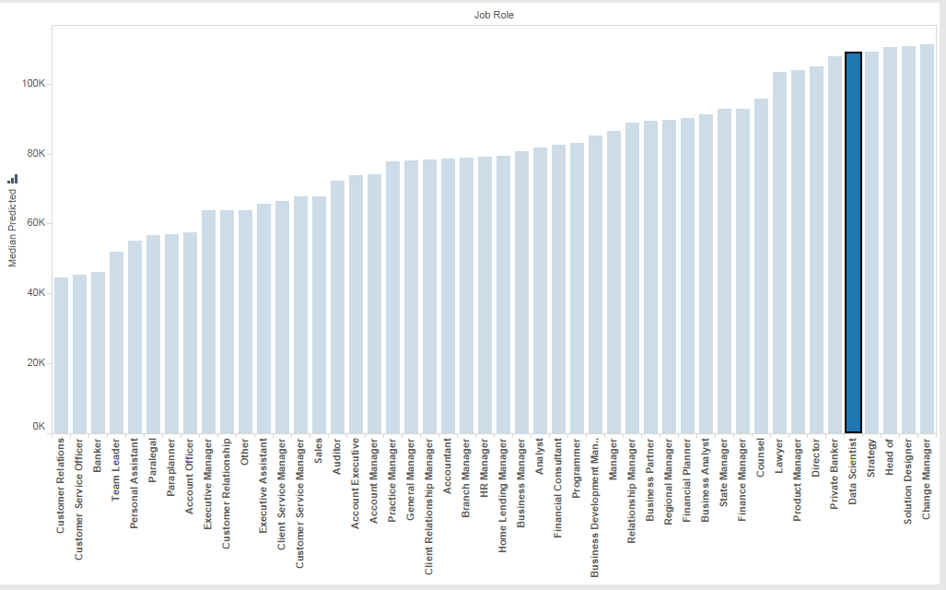
Productionised Model
Median Salary by Job Role

Slide 5

Data Science Job Role
Initial Data and Job opportunities available

Slide 6
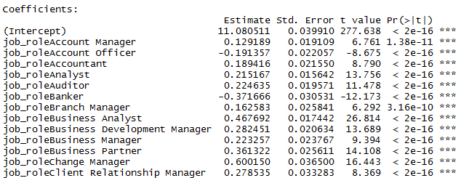
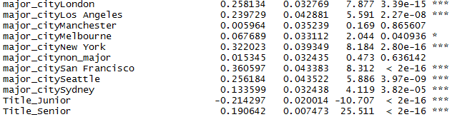

Model Coefficients

